Slide 1
Setup and Installation
JDK 11 and Spring Tool Suite (STS)

Slide 2
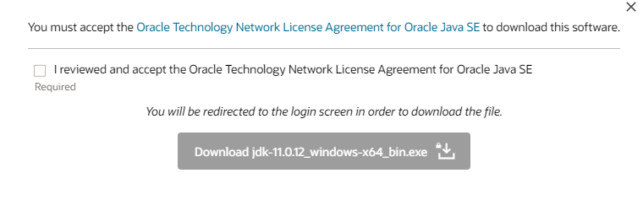
Installing JDK 11

Slide 3
Sign in to your Oracle Account

Slide 4
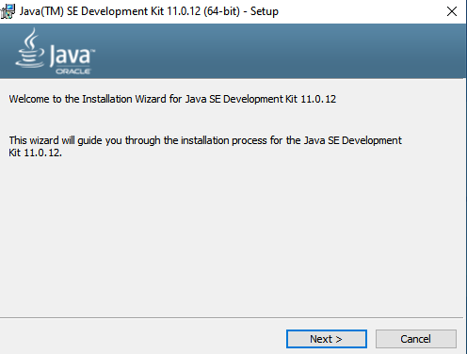
Download Installation File and Double Click it

Slide 5
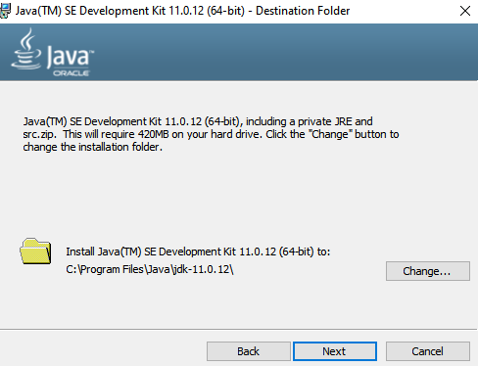
Choose installation folder

Slide 6
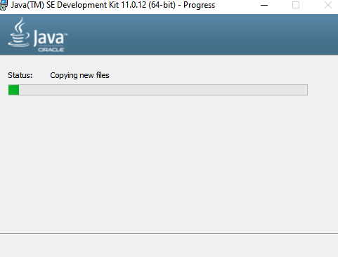
Wait for it to complete!

Slide 7
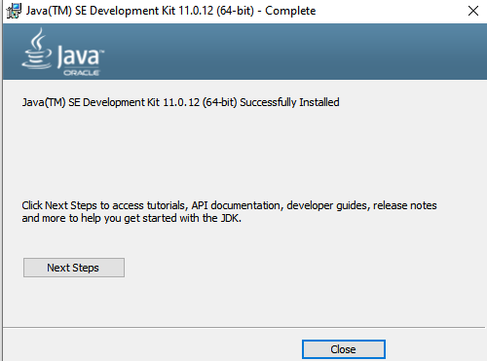
Success!!

Slide 8
Default Location of Java Installation Directory

Slide 9


Check installation at Command Prompt

Slide 10

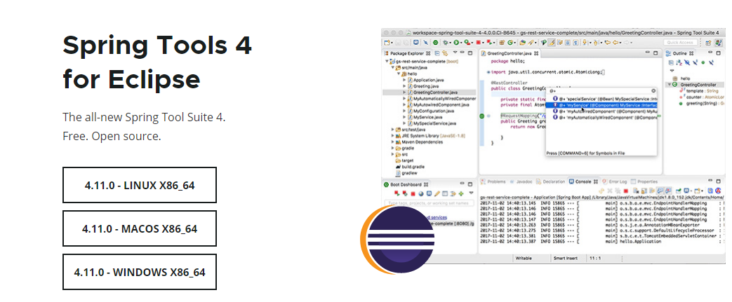
Installing Spring Tool Suite (STS)

Slide 11
Double Click self extracting jar

Slide 12
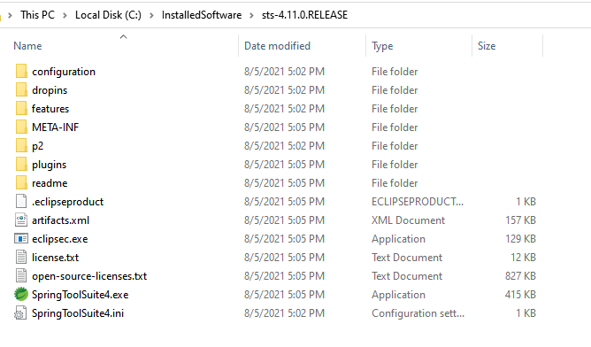
Install directory will be created

Slide 13
Cretae a Desktop shortcut and double click it

Slide 14
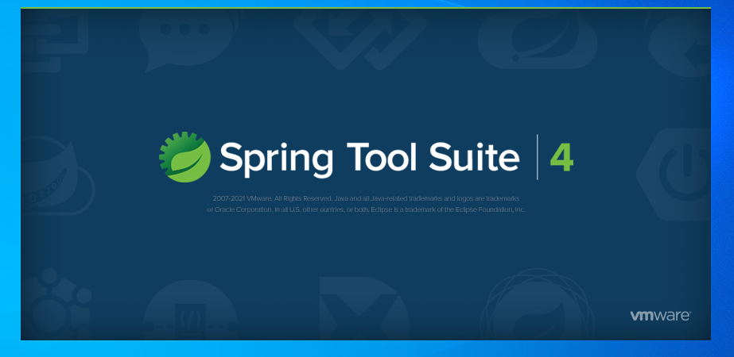
Spring Tool Suite will now launch

Slide 15
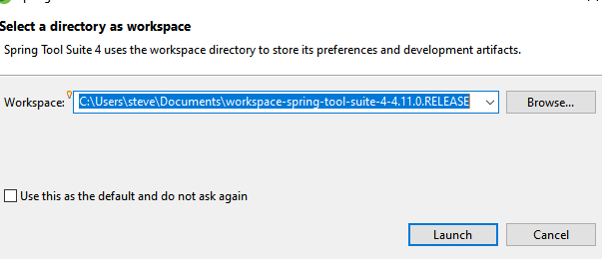
Select a\ workspace dialog

Slide 16
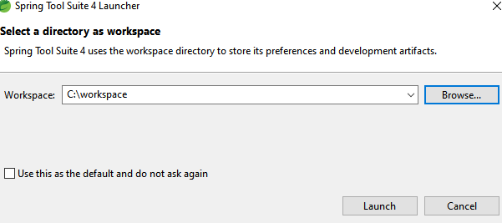
Select a workspace

Slide 17
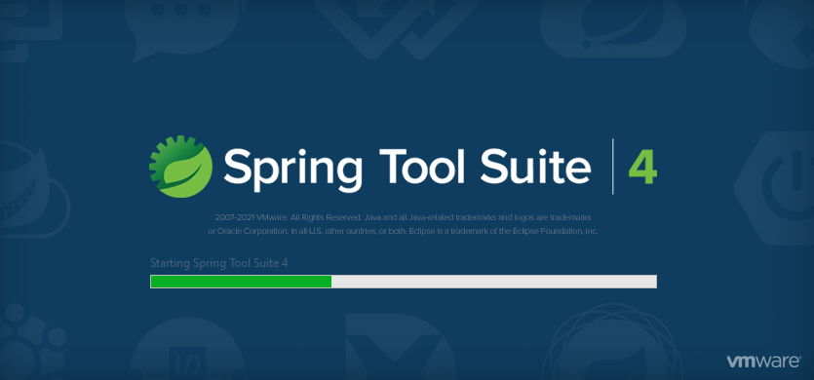
STS will open to the selected workspace

Slide 18
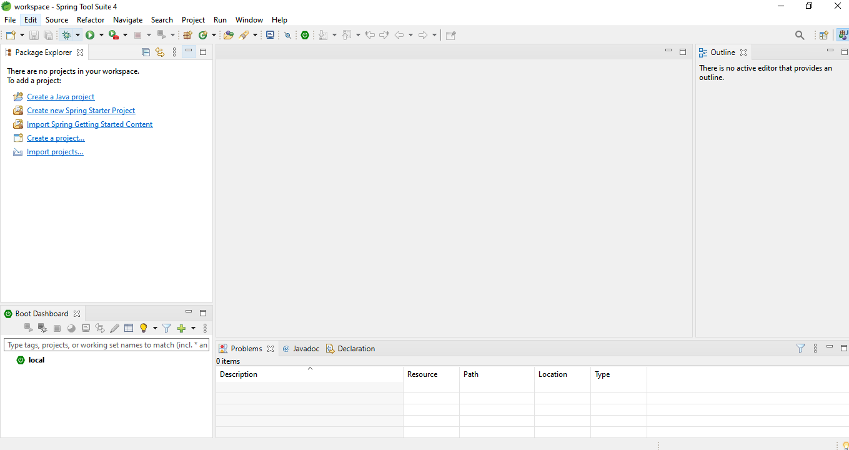
Spring Tool Suite workspace!!

Slide 19
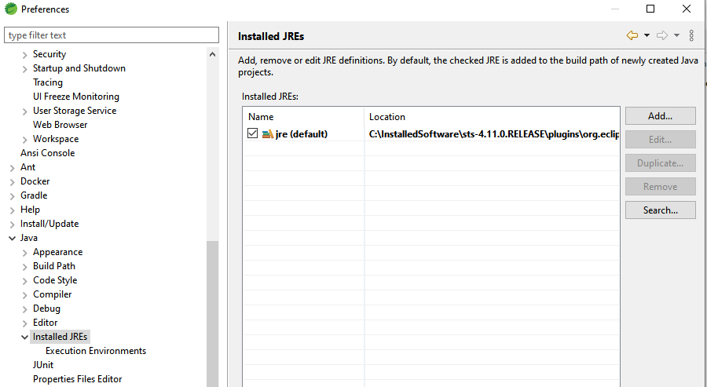
Customize “Installed JREs”

Slide 20
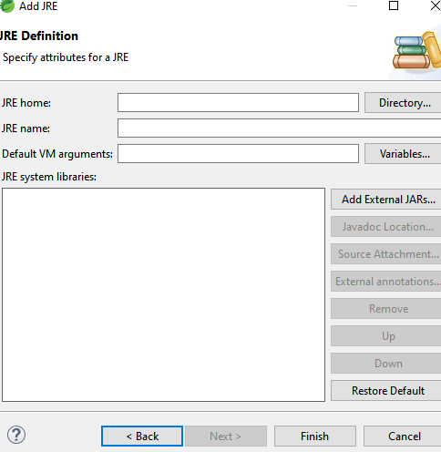
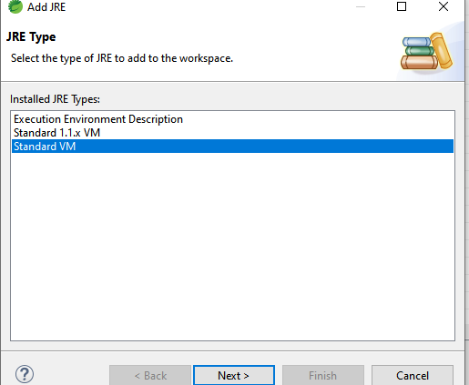
Set to location of root JDK installation directory

Slide 21
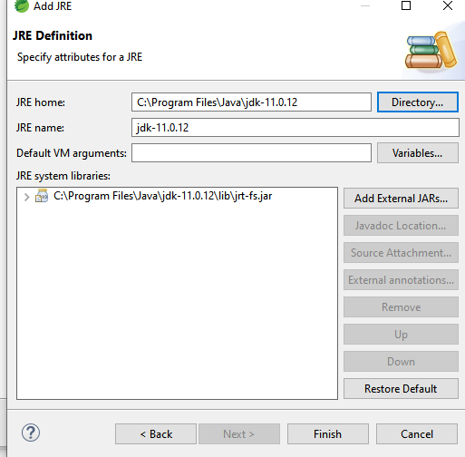
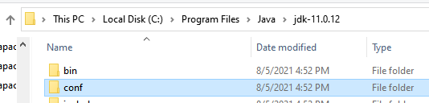
Set to location of root JDK installation directory

Slide 22
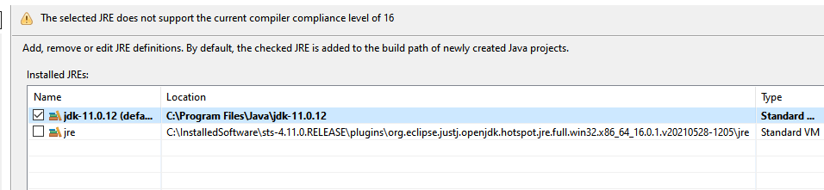
Set as Default

Slide 23
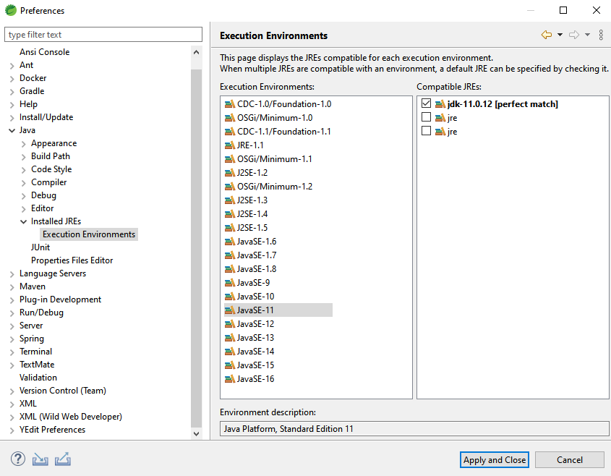
Change Execution Environment

Slide 24
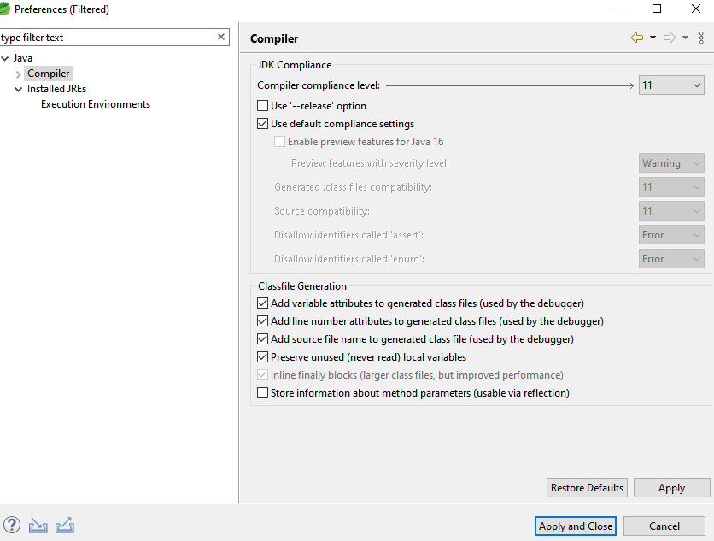
Change compliance level

Slide 25
Tips to increase STS performance

Slide 26
Window ==> Preferences

Slide 27
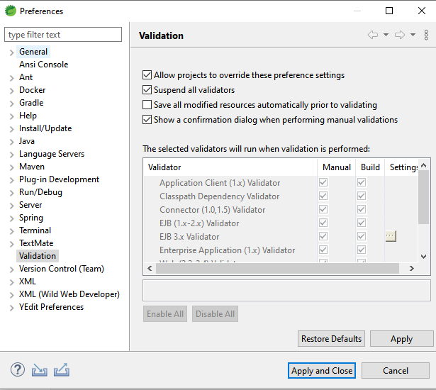
Suspend All Validators

Slide 28
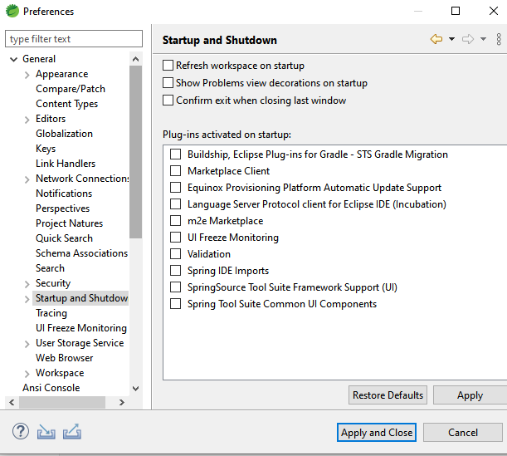
Disable Plug-ins activated on startup

